Slide 1
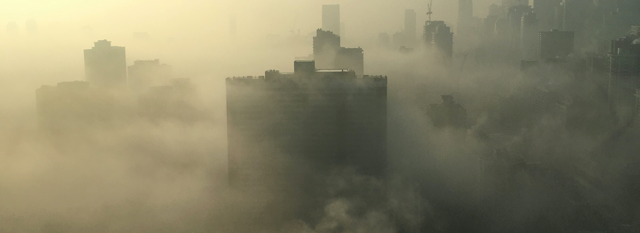
AQI vs death rate prediction
Nattawaree Piyarat
Brainstation – data science bootcamp

Slide 2

Problem statement
Can we use machine learning to predict how will the air quality index be in the next 5 years?
Is there any relationship between air quality and health (death rate) and what are the factors that impact air quality? Nowadays, we know what will impact air pollution (wildfire, dust, car, manufacturing)
Focus group AQI and number of deaths in selected Asian countries and compare between low AQI and high AQI areas.
  Bangladesh
  Bhutan
  India
  Indonesia
  Sri Lanka
  Thailand
Notes:
Factor

Slide 3
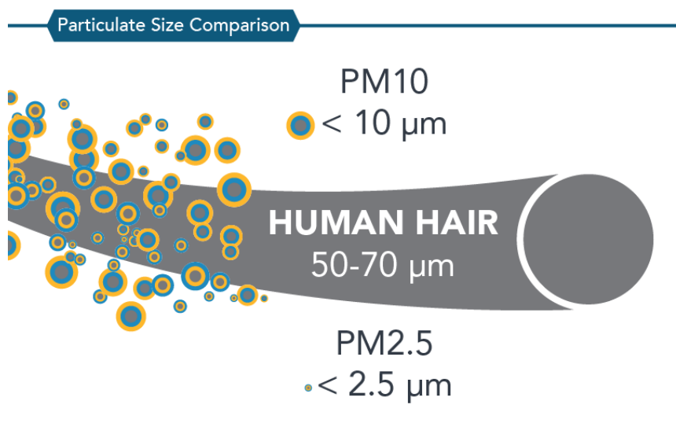
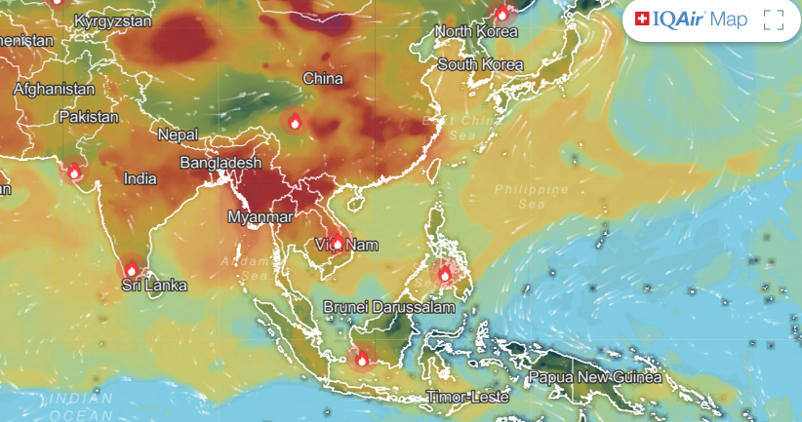
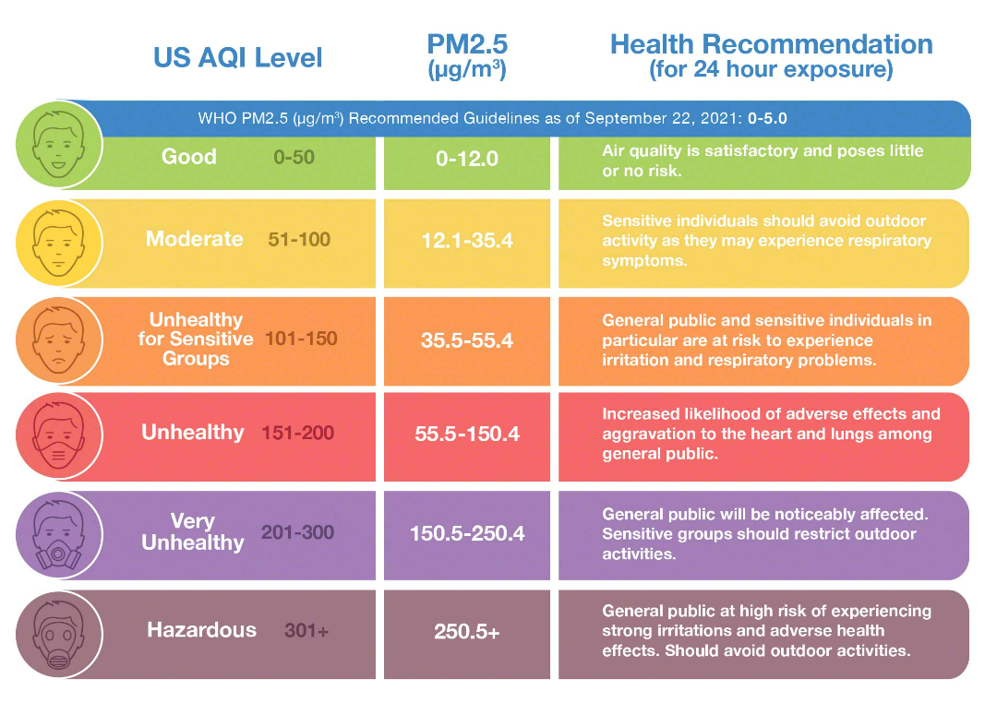
AQI (Air quality index)
Picture from IQAir website
PM 2.5 meaning: Fine particulate matter is defined as particles that are 2.5 microns or less in diameter

Slide 4


Data Science
The machine learning approach will be using historical AQI data, and historical death causes data. And predict the relationship between air quality and the number of deaths which is assumed that caused by high AQI.
Approach
  Logistic Regression
  Time series
The results of this project should raise awareness of air pollution and reduce the number of deaths of people by at least 1%, especially in the concerned areas.

Slide 5


Data set
Dataset from WHO database (Air quality index, number of deaths by cause, pollution, dust, wildfire)
Currently, I reference to datasets below.
Air quality index year 2000 – 2019 from WHO
  Country, City
  Year
  Number of PM10, PM2.5, NO2
Number of deaths by cause year 2016 – 2019 from WHO
  Country
  Year
  Age group
  Cause of death
  Number of deaths, death rate
Additional dataset
Study fact sheets and find some datasets about the causes of pollution and how they create bad air quality.

Slide 6
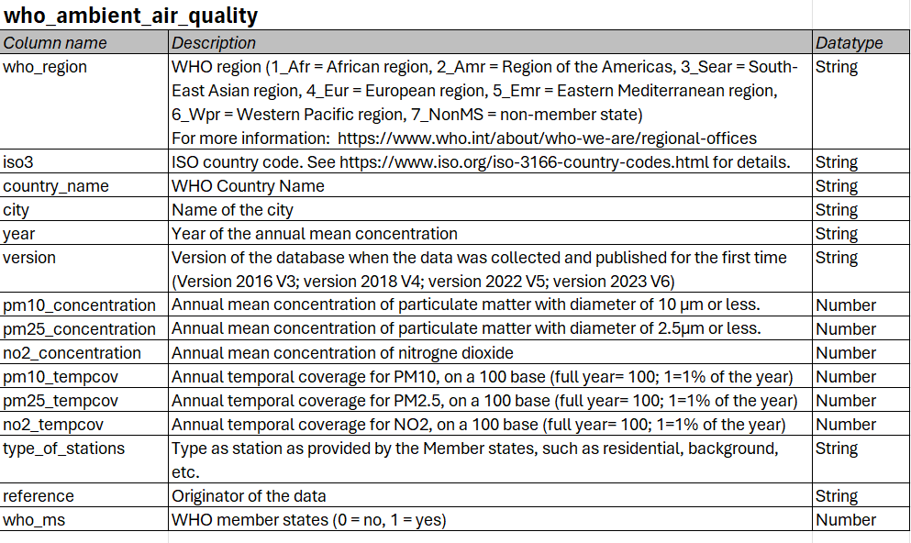
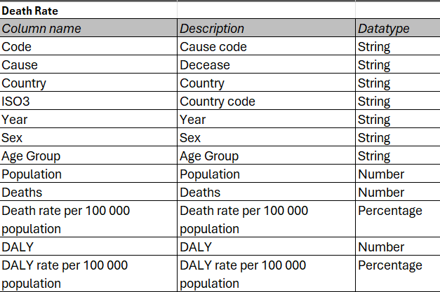
Data dictionary

Slide 7
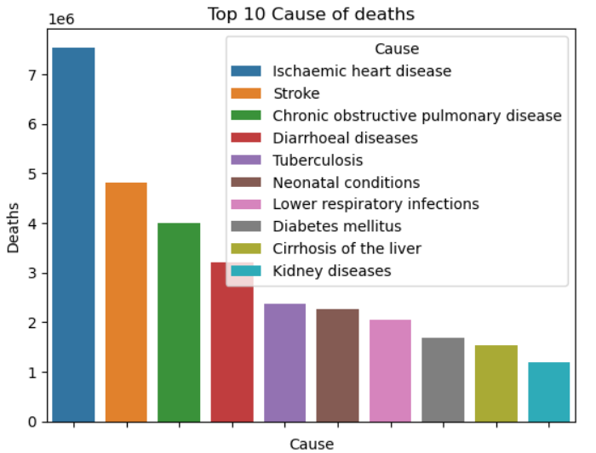
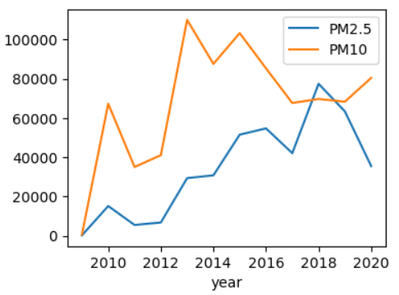
Finding
PM 10 peaked during 2013 – 2015 and PM2.5 increased and peaked in 2018.
Chronic obstructive pulmonary might come from air quality also Ischaemic heart disease.
Notes:
Remove 20-22

Slide 8
Next step
Add more data points in the Deathrate dataset (year, countries)
Add more datasets if any e.g. causes of pollution
Using machine learning to predict AQI and Death rate
  Logistic regression
  Time series
  Etc. (in case found proper other models)

Slide 9
Reference
WHO. WHO Ambient Air Quality Database (update 2023). Version 6.0. Geneva, World Health Organization, 2023.

